Slide 1
MVC Structure and Application in Web Apps
Presentation by Umit Hayim

Slide 2
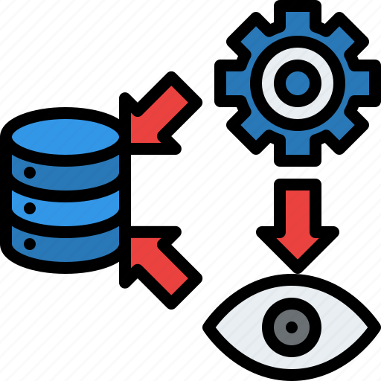
What is MVC?
Contrary to popular belief it’s not a framework, it’s an architectural paradigm.
By separating our model into three segments, we process information and structure our application in a more organised and manageable way.
We call it “Model View Controller”

Slide 3
But why aren’t we using less files?
It’s harder to organise,
If the code gets big, it’s harder to make modifications and not affecting the rest of it,
Harder to find anything,
To simplify, it’s less efficient and more time consuming!

Slide 4

So what are the benefits?
Easier to work with groups of people,
Debugging is less time consuming and if it breaks, it doesn’t affect the entire project,
It’s modular so it’s easier to swap out components to make changes.
We can have some interchangeability in our database

Slide 5
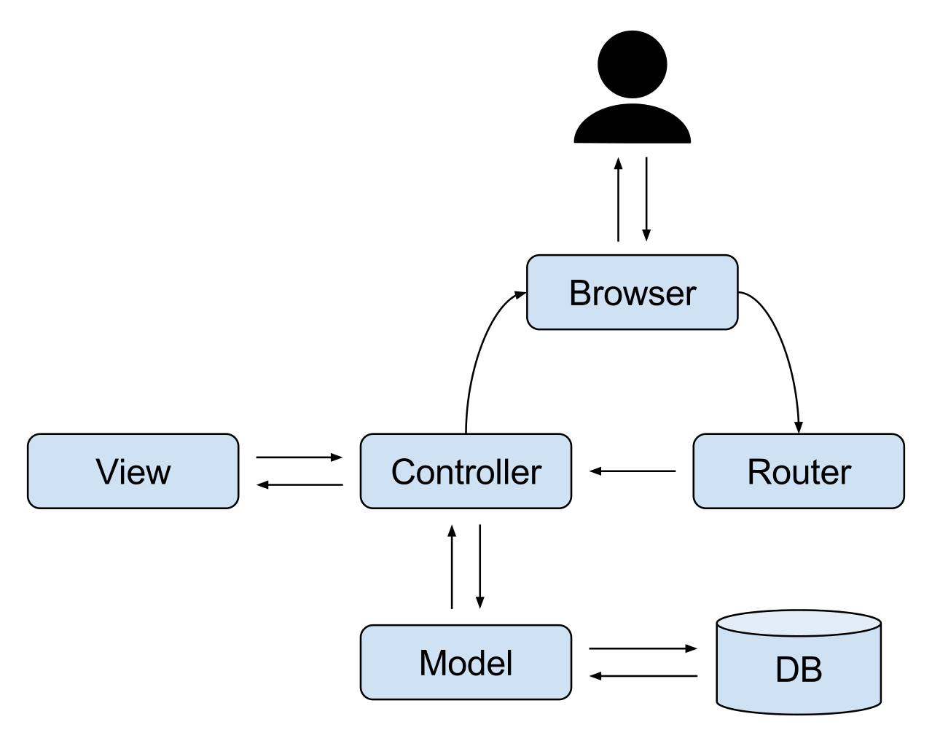
So what is going on…
The client-side (Browser, HTML/CSS/ JS) sends a request to the server(PHP/ Ruby/ Python),
The Server goes out to the Database(MySQL/PostgreSQL/ NOSQL/ MongoDB) for the request which has stored the information,
Database finds it and sends it to the Server,
Server processes the information and creates a page with HTML and CSS,
Finally client-side browser processes it and renders it on to the screen.
It all happens in a fraction of a second…

Slide 6
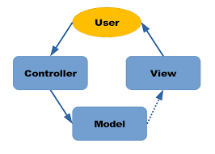
So what the heck is MVC?
Model: The Database
Adds and retrieves data from DB.
Speaks with Controller
View: Client
Is what is displaying information to the user and lets user to interact,
We can simply think of good old HTML/CSS,
Speaks to only Controller
Controller: Server
Is what interacts with the user,
It controls all server-side logic,
We call it the middleman since it dictates how application behaves and what data is sent between User, View and DB

Slide 7


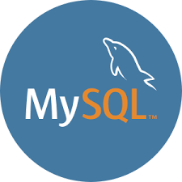

Views are created “templating languages”
Handlebars
EJS
Pug
Nunjucks
…etc.
Models are implemented using large scale data storage

Slide 8
Getting into more nits and grits…
The client-side device using the browser makes a request,
There is a code in our server that listens to the request and knows where to go next, which is the Router,
The Router job is to hand all the requests to the controller,
The controller either hands the request off to the View or the Model depending on the type of the request.
5.a If it’s a get request, it will have to go to model and then to DB. The controller after it gets the data from the database passes the data to the View, the View can use that data to build out the HTML and then the controller sends that HTML back to the client.
5.b If it’s a refresh, then it will only need some EJS to some HTML and the controller responds it.

Slide 9
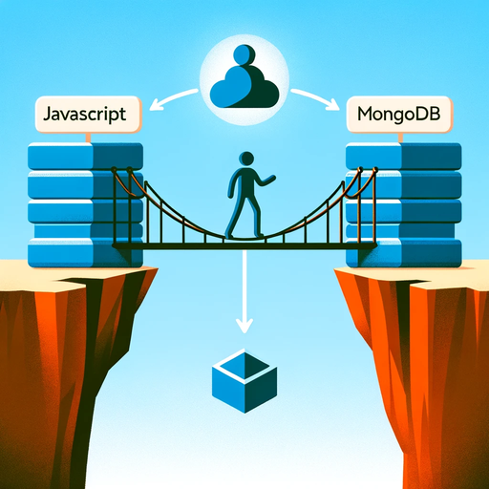
Understanding Mongoose for MongoDB
Mongoose Explained: It's a tool that makes working with MongoDB databases much simpler. Imagine it as a translator between your JavaScript code and the database.
Role of Mongoose: It converts the instructions written in JavaScript into a format that MongoDB can understand, making sure your data is handled correctly.
Data Validation Feature: Before any data gets into the database, Mongoose checks it for errors. This is like having a quality check to ensure everything is correct and orderly.

Slide 10
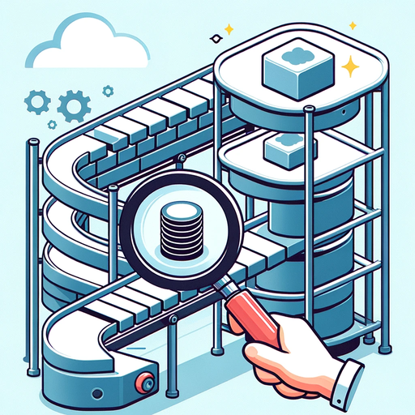
So why use Mongoose?
It streamlines database operations,
Provides a way to check your data for issues before it's stored,
Helps organize your data with structure.

Slide 11
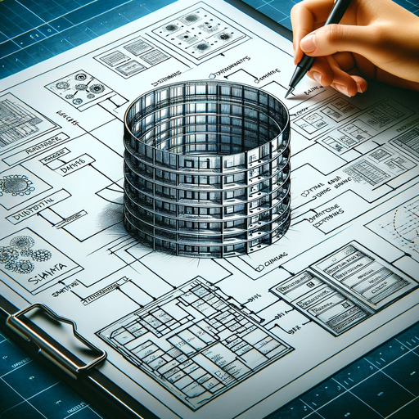
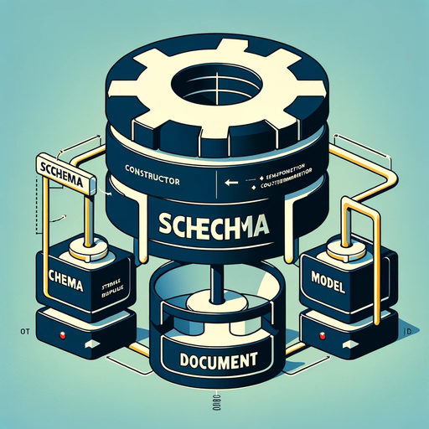
Schemas & Models in Mongoose
Understanding Schemas: A schema acts as the blueprint or structure for data in MongoDB. It defines the shape of documents within a collection by specifying data types, required fields, and other validation rules. Think of it as the architectural plan for data that ensures everything is built correctly.
Role of Models: Models are the power tools built on top of schemas. They take a schema and use it to create instances of documents, which are like the individual records you might find in a relational database. In simple terms, if your schema is the blueprint, then a model is the machine that builds the house according to that blueprint.

Slide 12

How They Work Together?
Schemas lay down the rules for what data should look like, while models enforce these rules and interact with the database.
They work in tandem to ensure data integrity and provide a structured and efficient way to manage data within your application.

Slide 13
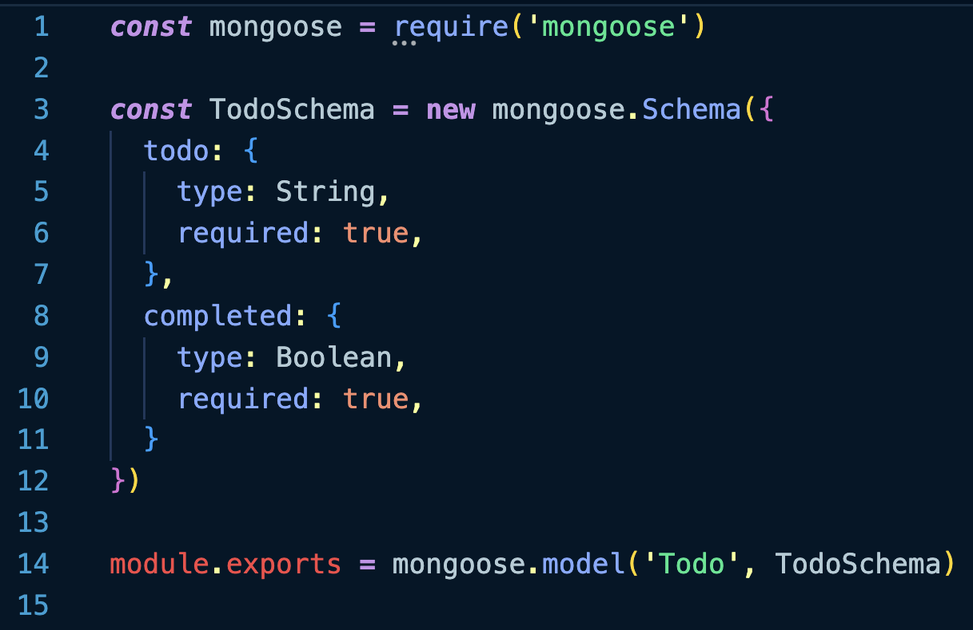
Example: Using Mongoose Schema

Slide 14



Thank You
https://twitter.com/umthym
https://www.linkedin.com/in/umit-hayim-0a07aa1a9/
https://github.com/UmtHym

